Slide 1
Conversations and talks
NU Engels unit 6.1

Slide 2
Grammar: Articles
(lidwoorden, p. 177)
Which is the correct form?
1. We have a/an new car.
2. Look at a/the house over here!
3. She went home at four in an/the afternoon.
4. Let’s go to a/the party.
5. This is a/the most difficult project ever.
6. It’s an/the eleventh of March.
→ When don’t you need articles at all?

Slide 3
Zero article
(geen lidwoord)
Names (John, London, England, Europe)
Days of the week and months (Wednesday, November)
Indefinite nouns in plural (Kangaroos are common in Australia.)
Uncountable indefinite nouns (Dutch people eat a lot of cheese.)
Languages and nationalities (I speak English. / I’m Dutch.)

Slide 4
Conversations and talks
NU Engels unit 6.2

Slide 5
Vocabulary: adjectives
See handout

Slide 6
Grammar: Comparisons
(trappen van vergelijking, p. 181)
Which sentence is correct?
We need a bigger car.
We need a more big car.
She bought the expensivest dress in the shop.
She bought the most expensive dress in the shop.

Slide 7
Writing: comparison
Compare Noorderpoort to your previous school(s).
What is easier: working in a hospital or visiting patients/clients at home? Why?
Life without computers would be better. Do you agree?

Slide 8
Conversations and talks
NU Engels unit 6.3

Slide 9
Grammar: Quantifiers
(hoeveelheid p. 185)
a lot of / lots of
much / many
a little / little
a few / few
Which ones are used with countable (telbare) nouns?
Which ones are used with uncountable (ontelbare) nouns?

Slide 10
What is the difference?
It takes a lot of time to write a book.
It takes much time to write a book.
I have a few good friends.
I have few good friends.
We need a little time to finish.
We need little time to finish.

Slide 11
Conversations and talks
NU Engels unit 6.4

Slide 12
Descriptions
A product
A holiday
A place/workplace
A person/patient
A building

Slide 13
Adverb + Adjective
(bijwoord + bijvoeglijke naamwoord)
It’s a big building.
It’s a very big building.
It’s an extremely big building.
It’s a really big building.
James is rich.
James is incredibly rich.
The phone is expensive.
The phone is ridiculously expensive.

Slide 14
Adjective → Adverb
He is a slow worker. → He works slowly.
She has a beautiful voice. → She sings beautifully.
What is the rule?
Exceptions (Irregular adverbs)
fast - fast
late – late
good - well

Slide 15
Position of adverbs
https://www.ego4u.com/en/cram-up/grammar/word-order/adverb-position
Woordvolgorde 2 - handout

Slide 16
Conversations and talks
NU Engels unit 6.5

Slide 17
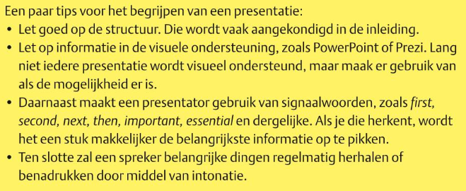
Presentation

Slide 18
Word order
(Woordvolgorde)
WIE – DOET – WAT – WAAR – WANNEER
of
WANNEER - WIE – DOET – WAT – WAAR

Slide 19
Word order - practice
Woordvolgorde 1 en 3 - handout

